Slide 1
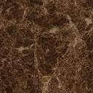

1
Chest,triceps
Back,biceps
Back or chest
Bicpe&tricep
3
shoulders
legs
2

